Slide 1
D.3 Encryption Methods– Apr 29
Agenda
  Virus Presentations
    Gursimrat
  Module D.3 Encryption Methods - Introduction
    Discussion: Simple Substitution
  B.4 Python File Handling – Recap
    Discussion: Binary Image Files
Upcoming
    Tomorrow: Complete Module D.3

Slide 2

Substitution Code
Simple Substitution

Slide 3
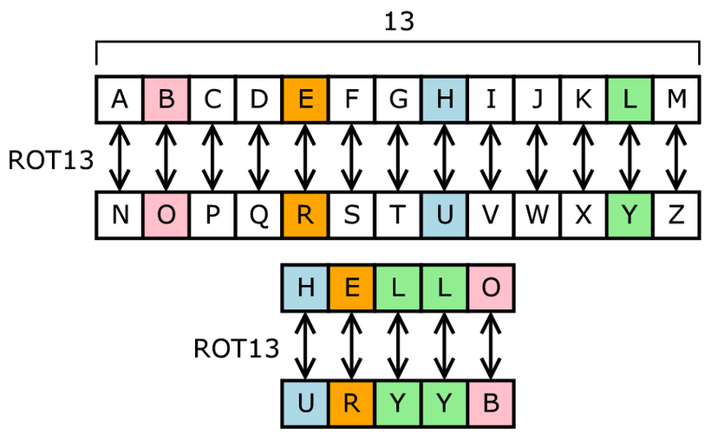
Substitution Code
Simple Substitution

